Slide 1
Exploratory Data Analysis
Unit 02 Lecture 03
Instructor: Dr Muhammad Ismail Mangrio

Slide 2
Contents
Elements of Structured Data
Rectangular Data
Estimates of Location
Estimates of Variability
Exploring the Data Distribution

Slide 3
Estimates of Variability
Location is just one dimension in summarizing a feature.
A second dimension,
variability, also referred to as dispersion,
measures whether the data values are tightly clustered or spread out.
At the heart of statistics lies variability:
  measuring it
  reducing it
  distinguishing random from real variability
  identifying the various sources of real variability
  making decisions in the presence of it.
Just as there are different ways to measure location (mean, median, etc.), there are also different ways to measure variability

Slide 4
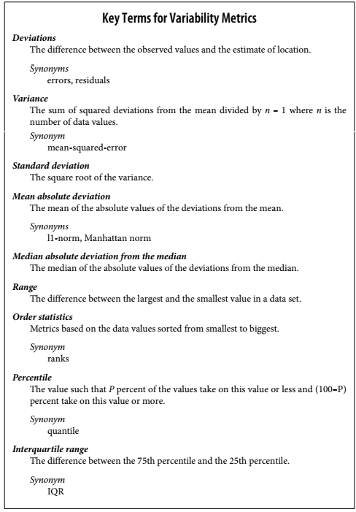
Estimates of Variability

Slide 5

Standard Deviation & Related Estimates
The most widely used estimates of variation are based on the differences, or
deviations, between the estimate of location and the observed data.
For a set of data {1, 4, 4}, the mean is 3 and the median is 4.
The deviations from the mean are the differences:
  1 – 3 = –2
  4 – 3 = 1
  4 – 3 = 1
These deviations tell us how dispersed the data is around the central value.
To avoid negative value, use absolute values in formula.
This is known as the mean absolute deviation and is computed with the
formula:

Slide 6
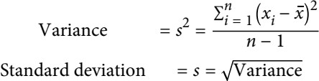
Standard Deviation & Related Estimates
The best-known estimates of variability are the variance and the
standard deviation, which are based on squared deviations.
The variance is an average of the squared deviations, and the standard deviation is the square root of the variance:
We use n-1 instead of n for sample data, will be biased if we use n.
However, it does not make any difference in results either to use n or n- 1, when the number of samples is a very large value.
Neither the variance, the standard deviation, nor the mean absolute
deviation is robust to outliers and extreme values.
6
Notes:
Dividing by n → assumes you know the true mean (used for population).
Dividing by n − 1 → adjusts for the fact that you estimated the mean from limited data (used for sample).
When you calculate variance or standard deviation:
Use n for population variance → np.var(data, ddof=0)
Use n - 1 for sample variance → np.var(data, ddof=1)

Slide 7
Standard Deviation & Related Estimates
The variance and standard deviation are especially sensitive to outliers since they are based on the squared deviations.
Standard deviation is preferred over the mean absolute deviation.
A robust estimate of variability is the median absolute deviation from the median or MAD:
  where m is the median.
Like the median, the MAD is not influenced by extreme values.
It is also possible to compute a trimmed standard deviation
analogous/similar to the trimmed mean.
7

Slide 8
Estimates Based on Percentiles
A different approach to estimating dispersion is based on looking at the spread of the sorted data.
Statistics based on sorted (ranked) data are referred to as order statistics.
The most basic measure is the range:
  the difference between the largest and smallest numbers.
The minimum and maximum values themselves are useful to know and are helpful in identifying outliers,
The range is extremely sensitive to outliers and not very useful as a general measure of dispersion in the data.

Slide 9
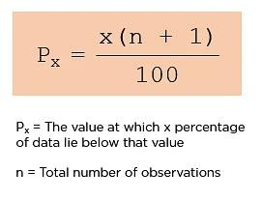
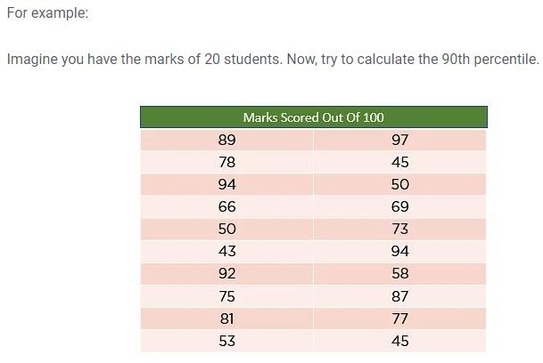
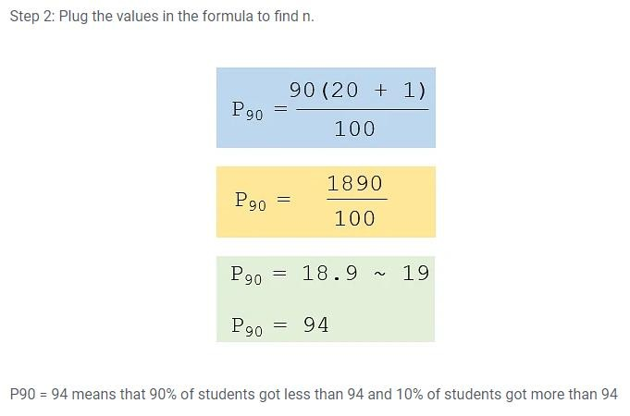
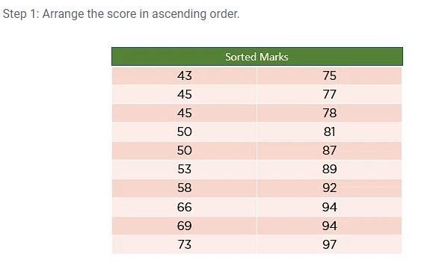
Estimates Based on Percentiles

Slide 10
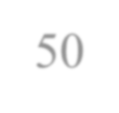
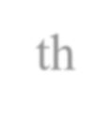
Estimates Based on Percentiles
To avoid the sensitivity to outliers, we can look at the range of the data after dropping values from each end.
Formally, these types of estimates are based on differences between percentiles.
In a data set, the P^{th} percentile is a value such that at least P percent of the values take on this value or less and at least (100 – P) percent of the values take on this value or more.
  For example, to find the 8o^{th} percentile, sort the data.
  Then, starting with the smallest value, proceed 80 percent of the way to the
largest value.
percentile.
The percentile is essentially the same as a quantile, with quantiles
Note that the median is the same thing as the 50th
indexed by fractions (so the .8 quantile is the same as the 80th ₁₀
percentile).

Slide 11
Estimates Based on Percentiles
A common measurement of variability is the difference between the 25th percentile and the 75th percentile, called the interquartile range (or IQR).
Here is a simple example: {3,1,5,3,6,7,2,9}. We
{1,2,3,3,5,6,7,9}.
  The 25th percentile is at 2.5, and
  the 75th percentile is at 6.5,
  so the interquartile range is 6.5 – 2.5 = 4.
sort these to get
Software can have slightly differing approaches that yield different answers (see the following tip); typically, these differences are smaller.
  For very large data sets, calculating exact percentiles can be
computationally very expensive since it requires sorting all the data values.
  Machine learning and statistical software use special algorithms, such as [Zhang-Wang-2007], to get an approximate percentile that can be calculated
very quickly and is guaranteed to have a certain accuracy.
11

Slide 12
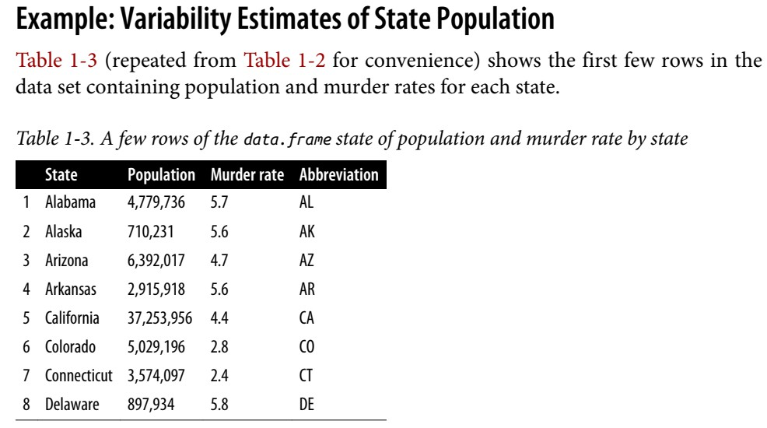
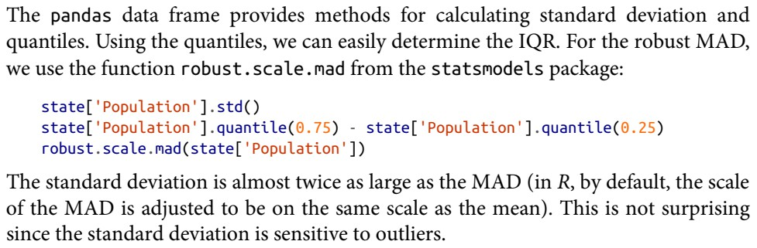

Slide 13
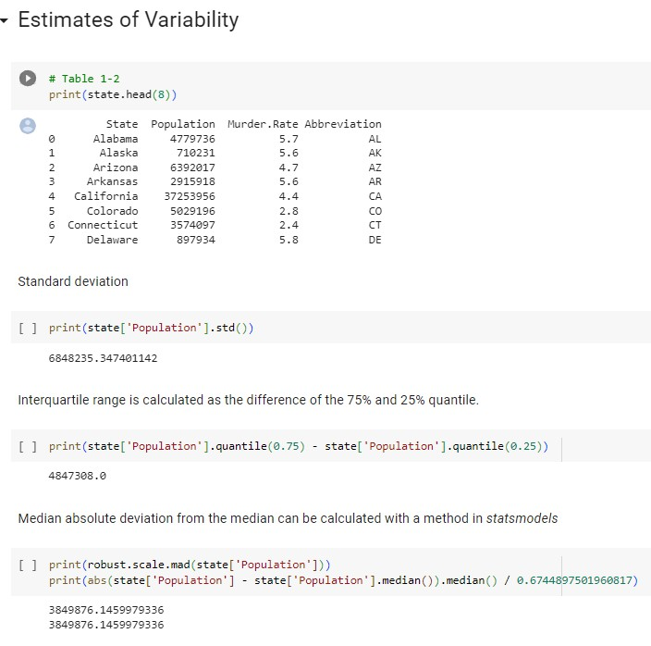

Slide 14
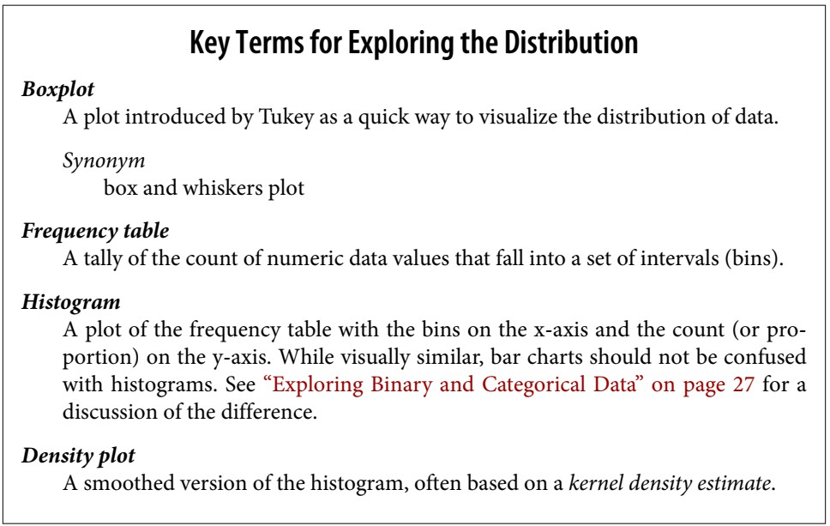
Exploring the Data Distribution
Each of the estimates we’ve covered sums up the data in a single number to describe the location or variability of the data. It is also useful to explore how the data is distributed overall.

Slide 15
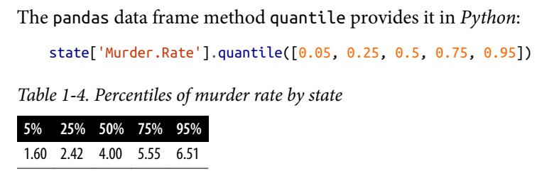
Percentiles and Boxplots
Percentiles are also valuable for summarizing the entire distribution.
It is common to report the quartiles (25th, 50th, and 75th percentiles) and the deciles (the 10th, 20th, …, 90th percentiles).
Popular culture has coined the term one-percenters to refer to the people in
the top 99th percentile of wealth.
The median is 4 murders per 100,000 people, although there is quite a bit of variability: the 5th percentile is only 1.6 and the 95th percentile is 6.51.

Slide 16
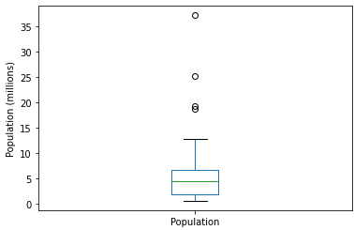
Percentiles and Boxplots
▶ Boxplots, introduced by Tukey [Tukey-1977], are based on percentiles and give a quick way to visualize the distribution of data. Figure 1-2 shows a boxplot of the population by state
▶ pandas provides a number of basic exploratory plots for data frame; one of them is boxplots:

Slide 17
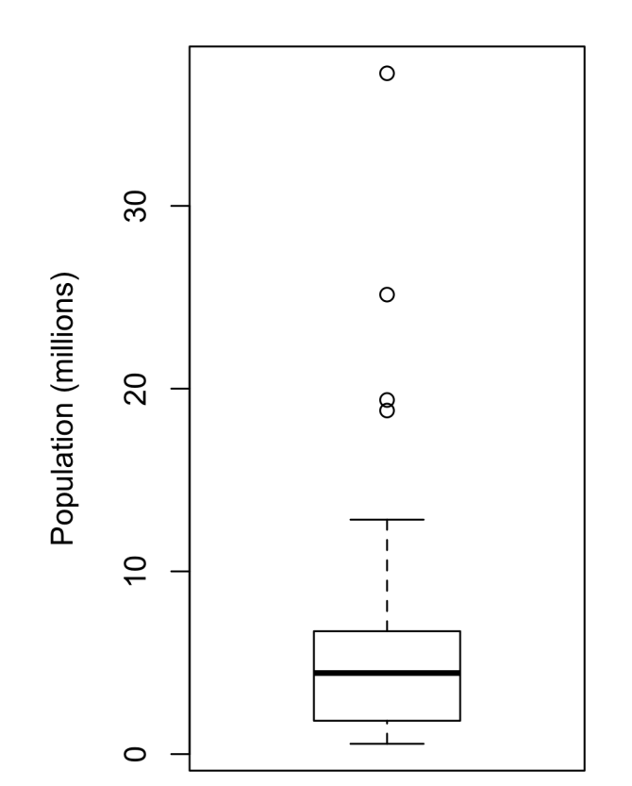
Percentiles and Boxplots
▶ From this boxplot we can immediately see that the median state population is about 5 million
▶ Half the states fall between about 2 million and about 7 million, and there are some high population outliers.
▶ The top and bottom of the box are the 75th and 25th percentiles, respectively.
▶ The median is shown by the horizontal line in the box.
▶ The dashed lines, referred to as whiskers, extend from the top and bottom of the box to indicate the range for the bulk of the data.
▶ Any data outside of the whiskers is plotted as single points or circles (often considered outliers).
▶ For range, Min and Max following formula is used:
▶ [Q1-1.5 * IQR, Q3+1.5*IQR]
▶ Min = Q1-1.5 * IQR
▶ Max = Q3+1.5*IQR

